Slide 1
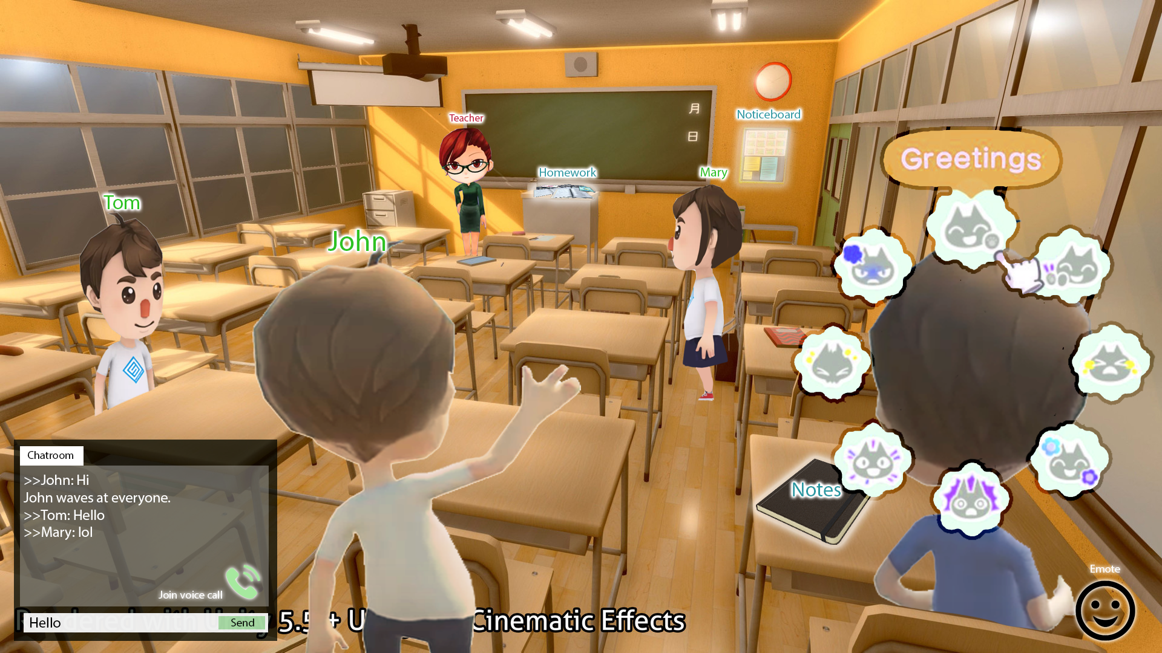
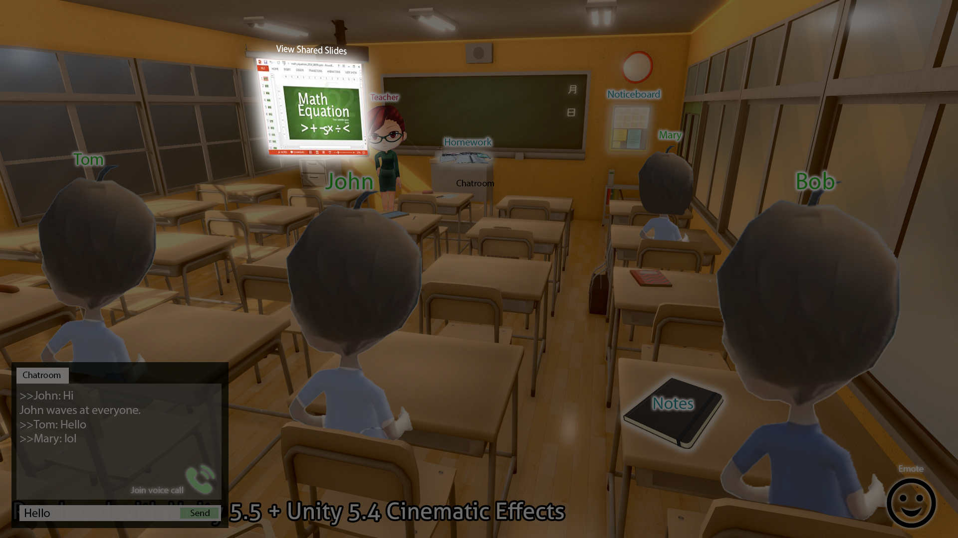
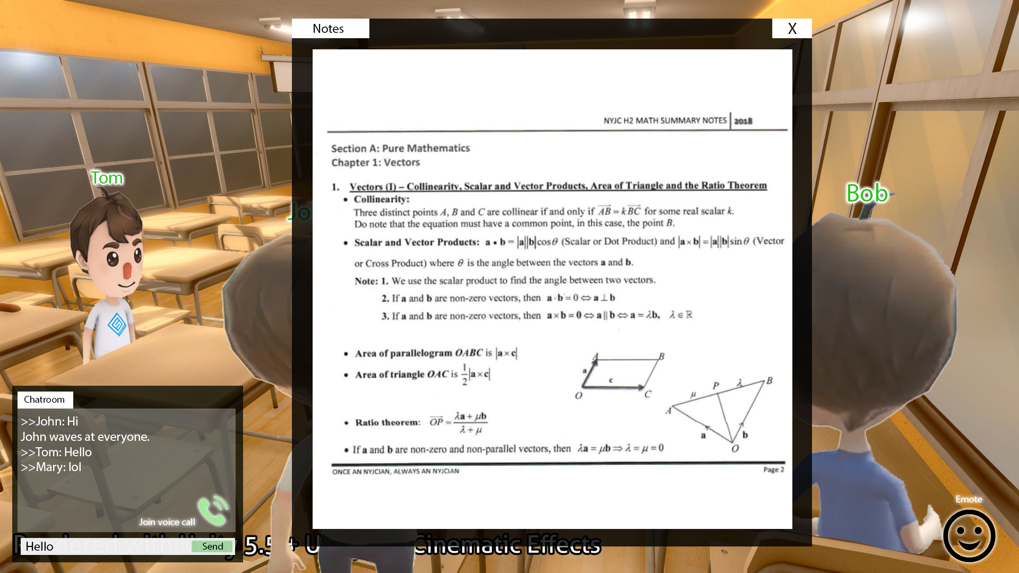
3D Virtual Classroom
Features
Objective
To make online lessons more engaging
Target primary / secondary school students
3D Model of a Classroom
Customizable Avatars
Interaction with others / classroom (emotes, actions, voice/ text chat) e.g. raise hand to ask a question, pick paper to look at the notes
Classroom elements e.g. Tutor can conduct a video call/ share their screen on virtual projector
Rules and Regulations e.g. Tutor can enforce students to mute / sit when presenting
Perspectives Tutor: toggle between classroom view and slide sharing view Students: toggle between fullscreen and class view
In-game currency Tutors can reward students who answer questions Students can buy virtual items (e.g. laptops, avatar customization options)

Slide 2

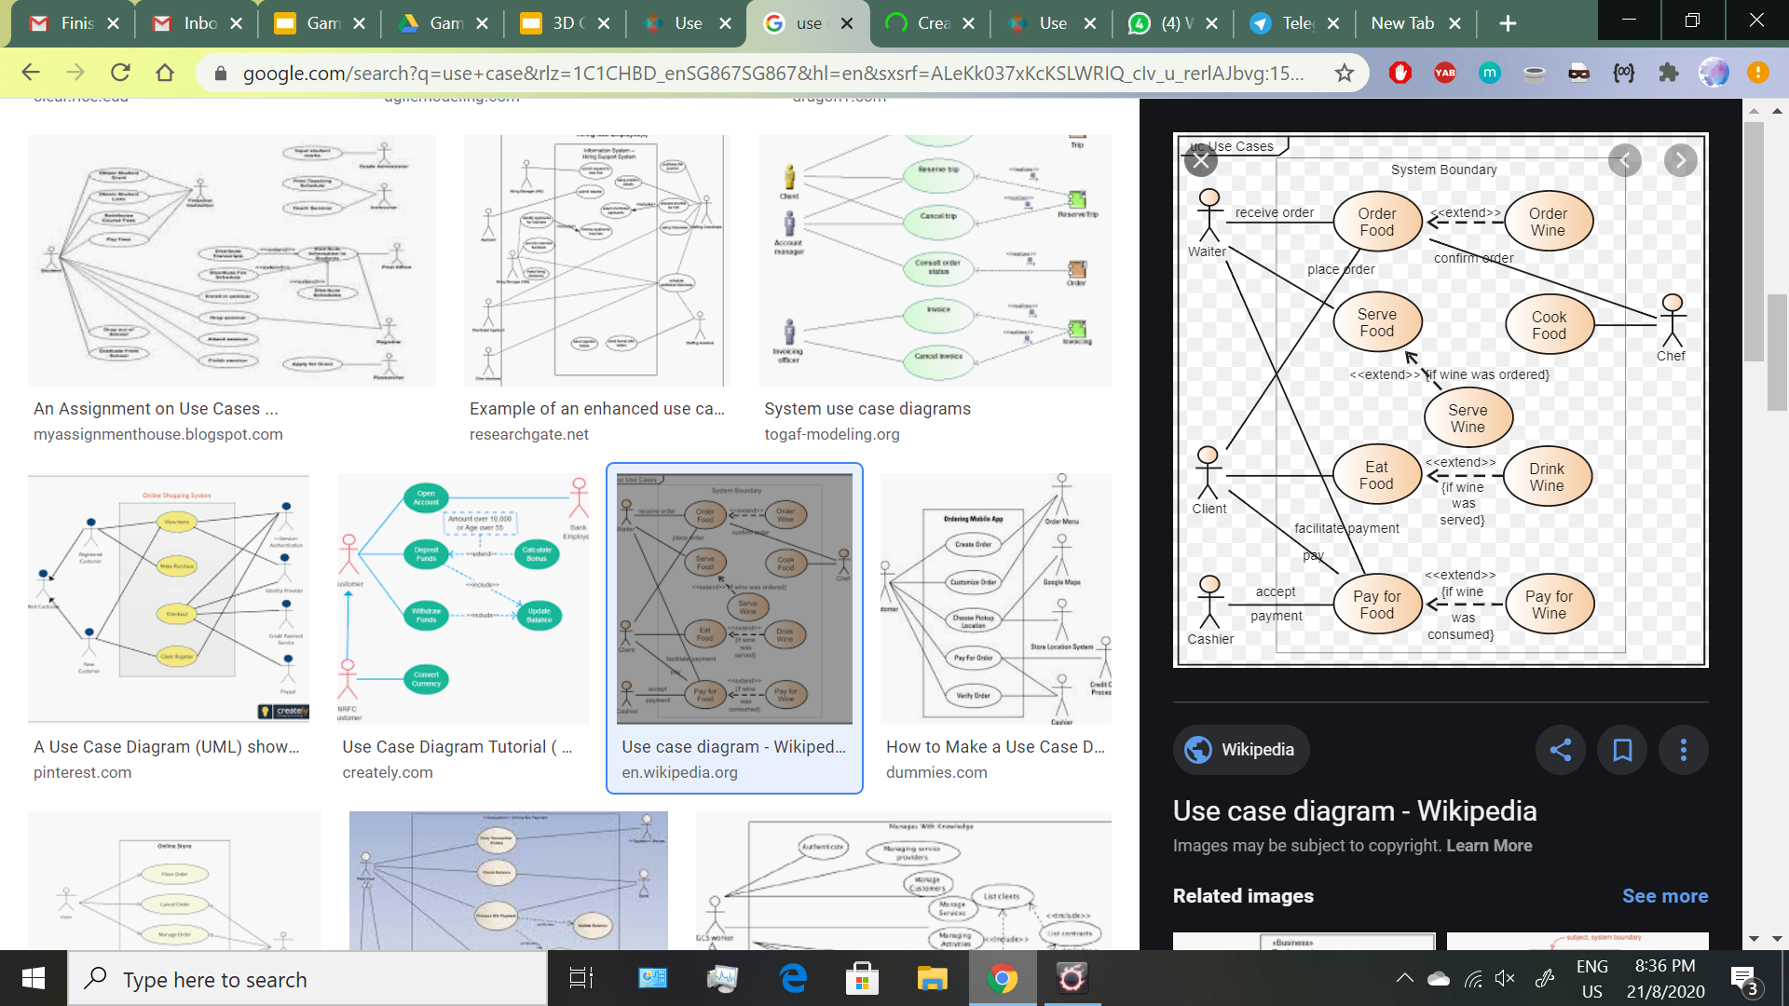

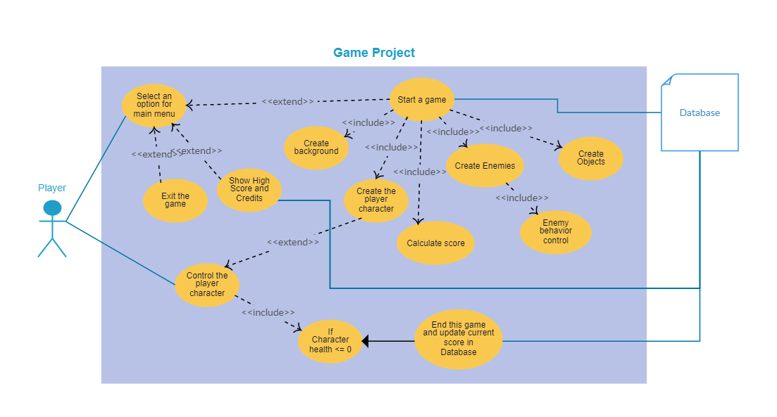
Use-Case
Create/
Log In Account
Control Access
Upload Lesson Materials
Distribute In-game Currency
View materials
(if given access)
Interact via emotes
Teacher (Admin)
Create/Edit Avatar
(If material uploaded)
Control avatar movement
Buy In-game items
(if given access)
(if currency sufficient)
(if given access)
Chat (text/voice)
(if given access)
Screenshare
Student
Annotate whiteboard

Slide 3
Possible Software - Unity
3D Modelling
Buy assets from unity store or import assets from online
Creating with blender
Pros
Game, it’s fun :D
Cons
Need to retrieve information
Not sure if it supports voice, video, chat, screen sharing
Security Issues
Notes:
https://www.slant.co/topics/7239/~engines-for-easily-creating-online-multiplayer-games
https://meliorgames.com/game-development/back-end-solutions-multiplayer-games/

